Slide 1
Lecture 3

Slide 2
Pointer declaration style
int* p;
int *p; //most preferred style
int * p;
Multiple declarations in the same statement
int x, *p, y;
x = 10;
p = &x;
y = *p; // accessing x throught p
*p = 20; // assigning 20 to x

Slide 3
Initialization of pointer variable
  int quantity;
int *p; // declaration
p = &quantity; //initialization
Combining initialization with declaration
int *p = &quantity; // this is initialization of p not
//*p
We must ensure that the pointer variables always point to the corresponding type of data.

Slide 4
Continue…
float a, b;
int x, *p;
p = &a; /* wrong , erroneous output */
int x, *p = &x; /* valid */
int *p = &x, x; /* invalid because declaration occurres left to right*/
If we want to declare a pointer for future reference after declaring a pointer, we can assign a null value.
int *p = NULL;
int p = 0;

Slide 5
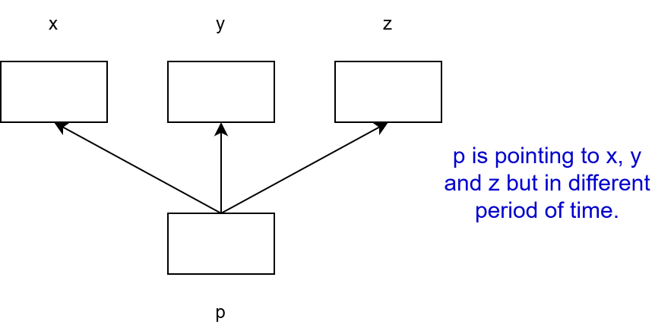
Pointer flexibility
We can make the same pointer point to different data variables in different statements
int x, y, z, *p;
p = &x;
p = &y;
p = &z;

Slide 6
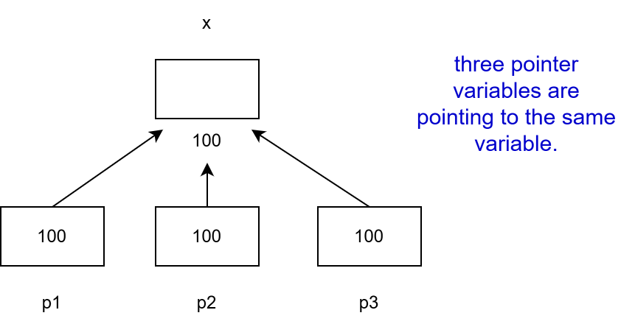
Continue…
We can also use different pointers to point to the same data variable.
int x;
int *p1 = &x;
int *p2 = &x;
int *p3 = &x;

Slide 7
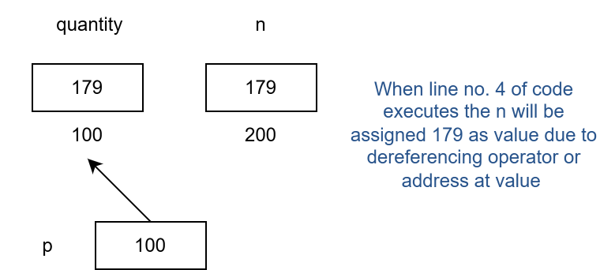
Accessing a variable through its pointer
* (asterisk) is also called the indirection operator and dereferencing operator.
int quantity, *p, n;
quantity = 179;
p = &quantity
n = *p; /*here asterisk is value at address

Slide 8
Continue…
Important points
p = &quantity
n = *p;
/* equivalent to */
n = *&quantity;
/*equivalent to */
n = quantity

